Slide 1
Army Welfare Trust
COORPORATE INSIGHT

Slide 2


Slide 3
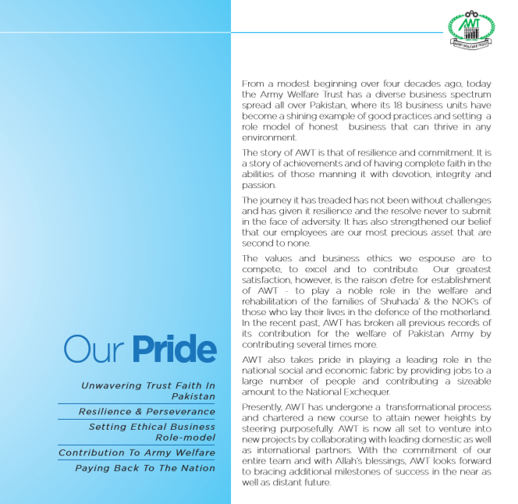

Slide 4


Slide 5
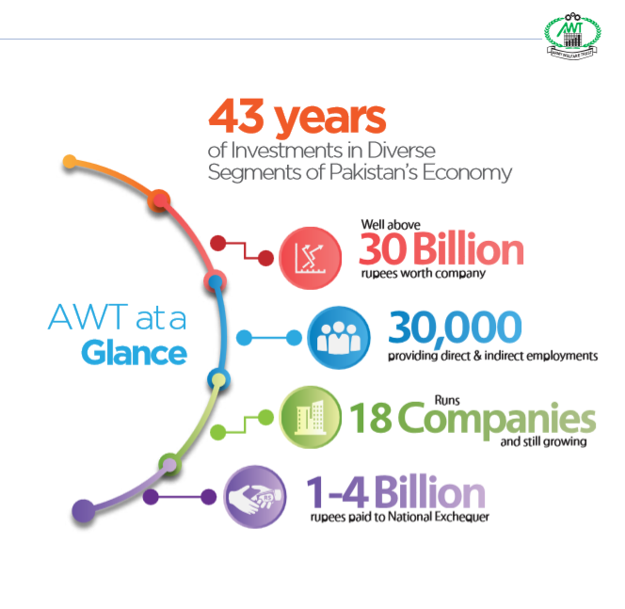

Slide 6


Askari Aviation Services is a dynamic aviation organization that is dedicated to the core principles of people and values. With almost 20 years in the aviation industry, Askari Aviation Services continues to be a leader in the industry with an enduring commitment to the quality, safety and respect of our people and our services. Brigadier Nadeem Aslam Khan (Retd), CEO is an experienced aviator and professional, leading a passionate team of over 150 employees including Professionals and Technocrats. An unwavering commitment to exceptional service, an unparalleled level of safety and security and an experienced, highly skilled team has earned Askari Aviation Services country wide reputation.

Slide 7

AT&T has two outlets. One is located in Blue Area, Islamabad and the Second is at Mall Road, Saddar Rawalpindi, with state of the art setup and reservation systems of Galileo and Abacus. The offices are manned by professionally qualiﬁed and highly experienced staff, to provide domestic and international travel services.
AT&T Islamabad is an International Air Transport Association (IATA) approved Travel Agency and AT&T Rawalpindi is Pakistan International Airline (PIA) Passenger Sales Agent (PSA).

Slide 8

Askari Airport Services (AAPS) is established as a project of Army Welfare Trust (AWT) under the Companies Ordinance, 1984. AAPS is mandated to carry on business of Ground Handling Services. It commenced its operations in January, 2007 offering quality services with a better cost effective structure, at Benazir Bhutto International Airport Islamabad.
AAPS is also a member of IATA Ground Handling Council (IGHC).

Slide 9
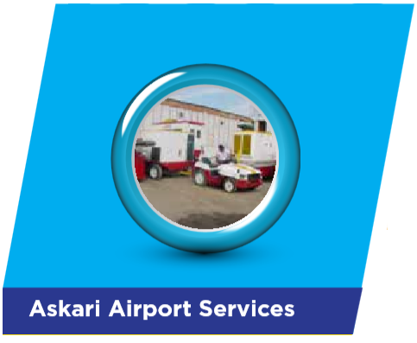
Askari Airport Services (AAPS) is established as a project of Army Welfare Trust (AWT) under the Companies Ordinance, 1984. AAPS is mandated to carry on business of Ground Handling Services. It commenced its operations in January, 2007 offering quality services with a better cost effective structure, at Benazir Bhutto International Airport Islamabad.
AAPS is also a member of IATA Ground Handling Council (IGHC).

Slide 10

Ask Flying Academy (AFA) is committed to achieve highest quality standards in training of aviation related personnel for issuance of licenses, certiﬁcates and ratings of the Civil Aviation Authority (CAA) of the approved courses. Syllabi and training curriculum of the following ﬂying and ground training courses have been approved by the CAA.
FLYING TRAINING COURSES
Private Pilot/commercial Pilot License Course
Flight Radio Telephony Operator License Course
Instrument Rating Course (Ir)

Slide 11

Askari general insurance company limited (Agico) was incorporated in 1995 as a public limited company and is quoted on all the three stock exchanges of Pakistan. It commenced its business in the same year and since then has by the grace of Allah maintained a steady growth with a network of 19 branches in different areas of the country and its head office based in Rawalpindi. With a team of professionals, Agico has achieved a higher ranking each year and has been able to rise up to A+ credit rating.
Agico’s business mix comprises of ﬁre, marine, engineering, bond, crop and travel insurance dominated by motor and health insurance segments. The company has evolved as a consistent player in the ﬁeld of non-life insurance segment in yesteryears and has managed to post underwriting proﬁts over the past many years.

Slide 12

Army Welfare Sugar Mills Badin commenced its journey with modest equity of Rs 10 Million and started its operation in February 1984 with meagre crushing capacity of 2,000 TCD which later on increased to 4000 TCD since 1995. Though still pretty small in terms of crushing capacity, by the grace of Allah, it can be termed as one of the leading projects of sugar industry in Sindh Province when measured through its performance. The project is being run on modern technique and is known for its transparent functioning viz a viz quick payment to growers, timely clearance of taxes and abiding by government rules. Besides providing jobs to ex-army personnel and their wards, the establishment has been assisting over 5,000 persons directly or indirectly to earn their livelihood in an exemplary environment.

Slide 13
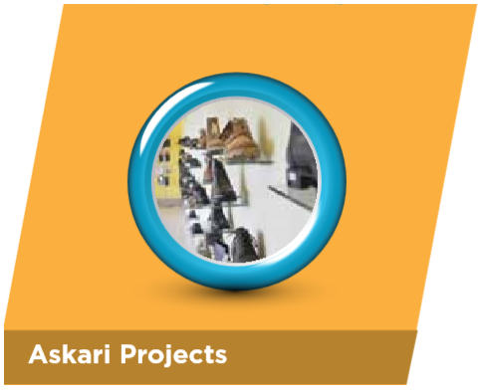
Established since 1990, Askari Shoes Project (ASP) is leading manufacturing unit of DMS boots in Pakistan. With best machinery from “BUSM, PFAFF, CIC RALPH & others, operated by highly skilled human resources, the factory is producing all types of quality military boots, safety shoes, jungle boots, desert boots and a variety of dress shoes.
ASP is also manufacturing and marketing a variety of dress shoes (CLASSICS), casuals (STALLIN), slippers/sandals (BATS) and children shoes (MARLIN). ASP has the maiden honour of introducing leather school shoes both for girls and boys.

Slide 14

Established in December 1996 as a joint venture Company of Exxon Mobil Corporation; the largest Oil Company in the world. AWT acquired 100% shares of the company from Exxon Mobil in 2007. The company operates a modern Lube Oil Blending Plant, markets Exxon Mobil products and has successfully developed and launched a wide range of other Brand Lube Oil products.
‘As the exclusive marketer of Mobil and ExxonMobil branded lubricants in Pakistan, the company has enjoyed unprecedented growth over the past decade and has developed an extensive sales network covering all major cities and lubricant business segments.

Slide 15

Farms and Seeds (F&S) have the distinction of being the ﬁrst economic enterprise of the Army Welfare Trust (AWT) which started in 1972 when the management of Pakistan Army’s farmlands at Probynabad, Boylegunj, Sukkur and Lahore was entrusted to the then newly established AWT. F&S now comprise 3x large Agriculture Farms at Dipalpur and Khuski beside a seed industry i.e. Askari Seeds which has three factories located at Lahore, Okara and Sangi (District Sukkur). The enterprise is mainly engaged in extensive conventional as well as modern agriculture to include crops ranging from wheat, cotton, maize, sugarcane, sunﬂower etc to vegetables and fruits of all sorts which are being grown regularly on the farm lands. Our seed industry too, is now one of the most reputed seed suppliers of the country who are helping the farmers of Punjab, Khyber Pukhtunkhwa and Sind, to enhance the yield and quality of their crops.

Slide 16
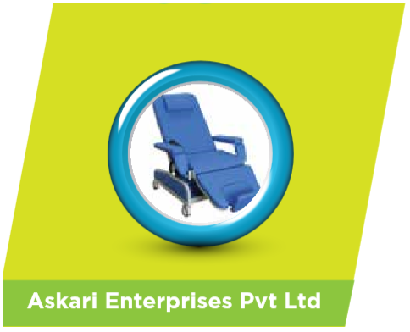
Army Welfare Trust (AWT) has established a dedicated wing for the supply of weapons, ammunition, vehicles, spare parts of chinese tanks & Armoured Personal Carrier , all wheeled vehicles spares, medical equipment for hospitals incliding high precision machines, laboratory equipment and other equipment/ stores to Pakistan Army, other services of the Armed Forces and civil Government Organizations along with trading of coal to cement factories, chromite and nephrite export to China, rice and commodities. The purpose of this wing is to ensure smooth and speedy supply of defense equipment/stores to meet the demand of defense organizations and to have business activities with other departments in the civil sector.

Slide 17

Askari Apparel is envisioned to be a fully compliant and state of the art manufacturing unit and export house based at Sunder Industrial Estate, Lahore. The excellence is strengthened by its strong ﬁnancial base, latest machines and a committed team of professionals. Our corporate mission is to be identiﬁed as a leading provider of the top quality garments for retail business globally. In our drive to provide a total solution and satisfaction to our clients, production lines are designed to accommodate variety of styles that run at a time.

Slide 18

Askari Guards (Pvt) Limited (AGL), a subsidiary of Army Welfare Trust, commenced its operations in 1996. It has No Objection Certiﬁcates (NOC) to operate in all provinces and Azad Jammu and Kashmir territory. AGL was also certiﬁed to operate with security companies of foreign countries. Right from its inception, the Company concentrated on providing quality guarding system to its clients and soon emerged as a recognized and trusted provider of guarding service to the well recognized national and multi-national companies.

Slide 19

Fauji Security Services (Pvt) Limited is providing the Human Guarding Security Services to the Clients spread all over Pakistan since 1993. Initially, it started the Security Business by providing security services to the outﬁts of the Fauji Foundation only. The provision of security services was extended to the clients other than the Fauji Foundation when FSS obtained the status of a Private Company in 2005. From 2005 onwards, FSS is providing the security services to the Individuals, Banking Sector, Government institutions, Oil & Gas Energy Sector, Educational Institutions, Hospitals and Corporate sector.

Slide 20

AWT RE (HO) is a leading market player in real estate industry of Pakistan. Credibility, Trust and Commitment to deliver affordable housing are core strength of our organization making us unique from rest of the players operating in the industry. Real Estate Business Unit was established in 1990. The idea for the establishment of RE (BU) was to develop housing schemes, acquire commercial properties and manage these as proﬁtable concerns.
Brigadier Tariq Mehmood Malik (Retd) is a veteran professional engineer leading this business unit. His problem solving techniques and vast experience in industry has revitalized the housing schemes and organization. RE (BU) has performance oriented, results-driven teams focused on ensuring peace of mind to our valued customers.

Slide 21
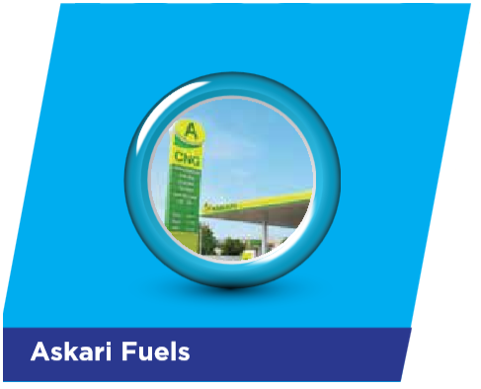
Askari Fuels (AWT) Project was launched in July 2002. In a span of 12 years it has developed into the largest CNG network in the country with 29 CNG stations. Our CNG network is spread in four provinces of Pakistan and AJ&K. We have diversiﬁed our business through joint venture with Attock Petroleum Limited. Our 12 CNG stations have been multi-fueled and one station is under construction. Although we are relatively new entrant in the ﬁeld of multi-fuel but have managed to establish our reputation as a progressive and dynamic organization, focused on providing quality petroleum products and services on our stations.

Slide 22
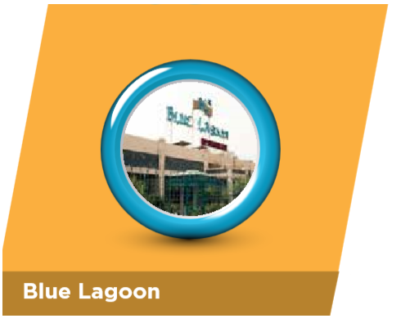
Blue Lagoon Restaurant is functioning since 1950s, its prime location off the beautiful and serene mall, next to Pearl Continental makes it one of the most attractive places to visit in Rawalpindi Cantt area. Blue Lagoon Restaurant is famous in Rawalpindi for Pakistani dishes, sizzling BBQ and for continental and Chinese dishes. Also houses four banquet facilities, most popular amongst the community.
Blue Lagoon swimming pool, the oldest in Rawalpindi Cantt has a state of the art swimming pool ﬁltration system with gushing fresh water. It has ideal arrangements to provide swimming training and coaching to children.

Slide 23
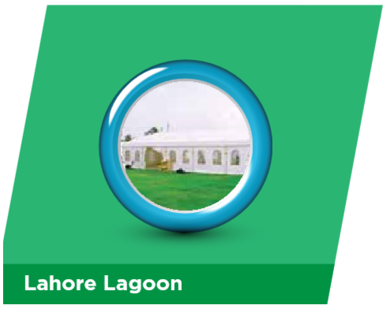
The twelve Kanal plot lying vacant, was converted into banquet facilities in 2011. Initially, the functions were held in tent for a limited time prior to import of marquee. Lahore Lagoon is an elegant banquet facility created by AWT in 2011 in the heart of Gulberg business district on Main Boulevard of Lahore. It caters for large banquets up till 800 – 1000 guests in a most comfortable and sumptuous environment in very affordable budget. The venue has huge parking facility besides being centrally located. An imported marquee installed recently has added advantage for arranging corporate functions.
This business unit has self sustained in revenue after paying back investment on the project. Based on this experience, similar banquet facilities are coming up at Faisalabad and Kharian cities. Askari Lagoon (Faisalabad) is going to be operational shortly, followed by Kharian next year.

